Slide 1
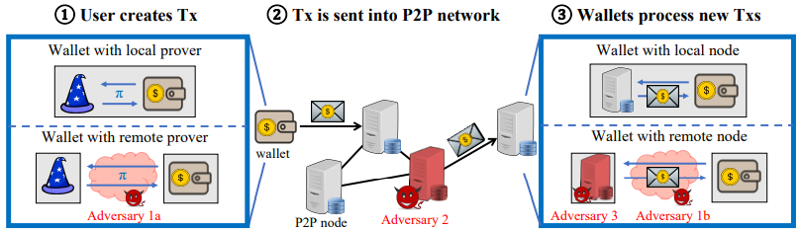
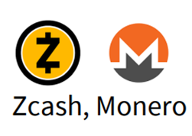
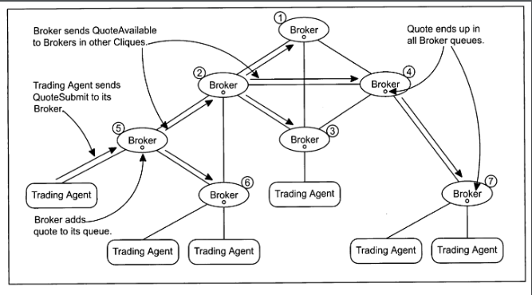
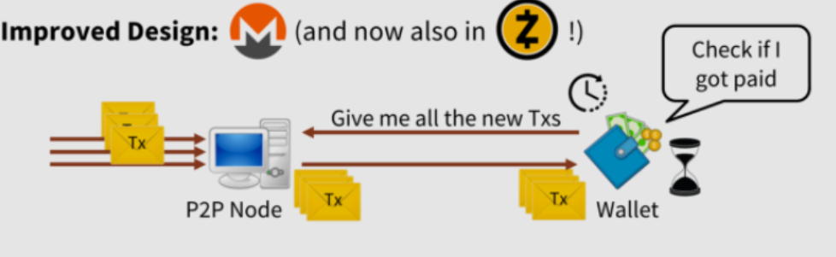
Remote Side-Channel Attacks on Anonymous Transactions
Attacks:
Attack Type I: Side-Channels at the Receiving Party
Attack Type II: Side-Channels at the Sending Party
Privacy goals:
Confidentiality
Untraceability
Unlinkability
User anonymity
Side-channels in the anonymous transaction life cycle
Architecture of
anonymous attack
(eg. Trading)
Attacks on Zcash:
The PING attack
The REJECT attack
Attacks beyond Recipient Discovery
Attacks on Monero:
Traffic Analysis Attacks for Remote Nodes
Timing Attacks for Remote Nodes
Timing Attacks for Local Nodes
One of the remediation process

